Slide 1
Security of
ComputerSystems
Dr. Iliya Georgiev
Remark: Some of the slides follow the book “Computer Networks, Kurose and Ross”
Adapted by Prof. Dr. I. Georgiev, MSUDenver
Prof. Dr. Iliya Georgiev Computer Systems Security
Notes:
Prof. Dr. Iliya Georgiev

Slide 2
The Security Problem
Security must consider external environment of the system, and protect the system resources
Intruders (crackers) attempt to breach security
Threat is potential security violation
Attack is attempt to breach security
Attack can be accidental or malicious
Easier to protect against accidental than malicious misuse
Prof. Dr. Iliya Georgiev Information Systems Security
Notes:
Prof. Dr. Iliya Georgiev

Slide 3
Security Violations
Categories
  Breach of confidentiality
  Breach of integrity
  Breach of availability
  Theft of service
  Denial of service
Methods
  Masquerading (breach authentication)
  Replay attack
    Message modification
  Man-in-the-middle attack
  Session hijacking
Prof. Dr. Iliya Georgiev Information Systems Security
Notes:
Prof. Dr. Iliya Georgiev

Slide 4
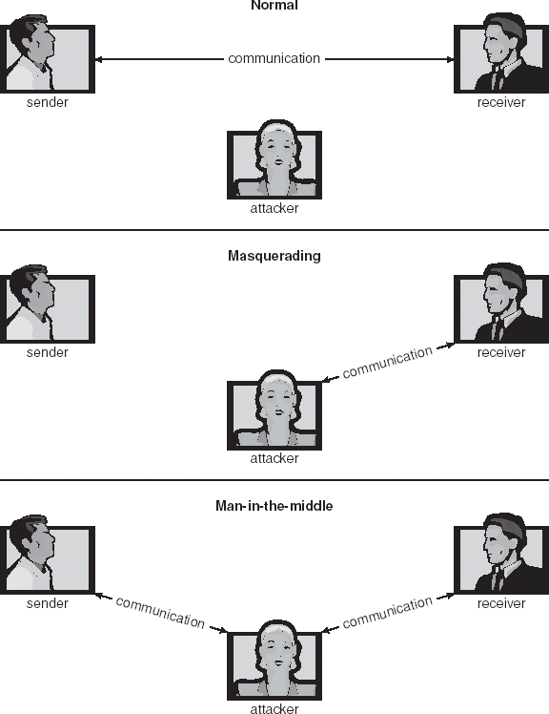
Standard Security Attacks
Prof. Dr. Iliya Georgiev Information Systems Security
Notes:
Prof. Dr. Iliya Georgiev

Slide 5
Security Measure Levels
Security must occur at four levels to be effective:
  Physical
  Human
    Avoid social engineering, phishing, dumpster diving
  Operating System
  Network
Security is as week as the weakest chain
Prof. Dr. Iliya Georgiev Information Systems Security
Notes:
Prof. Dr. Iliya Georgiev

Slide 6
Program Threats
Trojan Horse
  Code segment that misuses its environment
  Exploits mechanisms for allowing programs written by users to be executed by other users
  Spyware, pop-up browser windows, covert channels
Trap Door
  Specific user identifier or password that circumvents normal security procedures
  Could be included in a compiler
Logic Bomb
  Program that initiates a security incident under certain circumstances
Stack and Buffer Overflow
  Exploits a bug in a program (overflow either the stack or memory buffers)
Prof. Dr. Iliya Georgiev Information Systems Security
Notes:
Prof. Dr. Iliya Georgiev

Slide 7
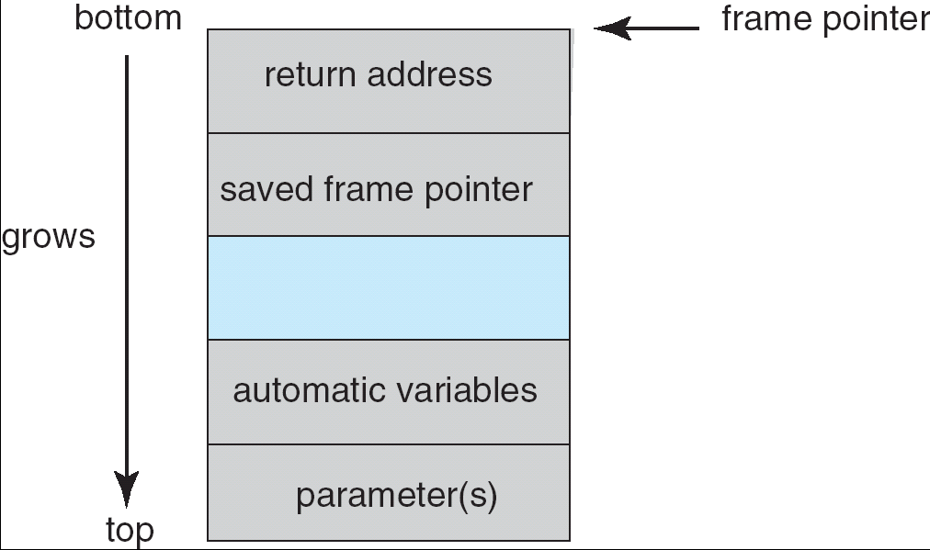
Layout of Typical Stack Frame
Prof. Dr. Iliya Georgiev Information Systems Security
Notes:
Prof. Dr. Iliya Georgiev

Slide 8
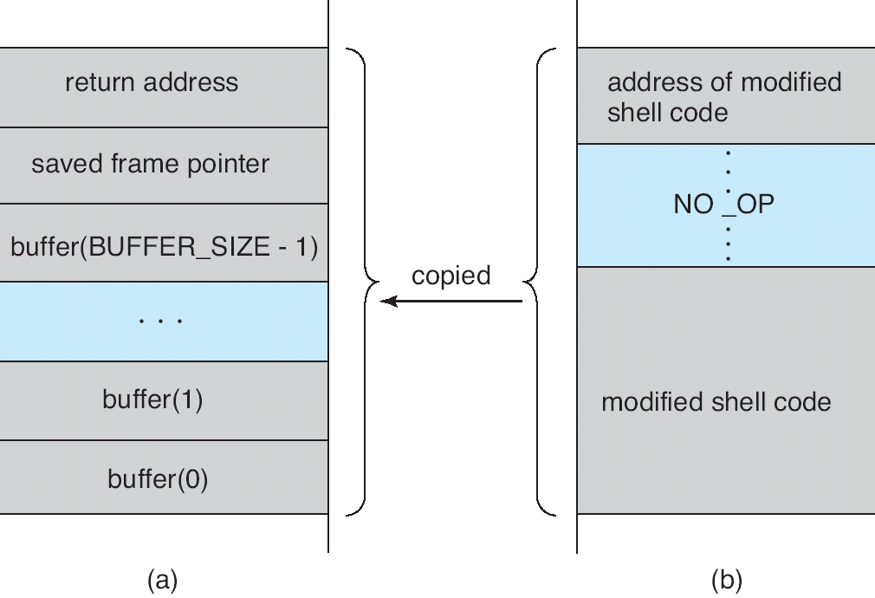
Hypothetical Stack Frame
Before attack
After attack
Prof. Dr. Iliya Georgiev Information Systems Security
Notes:
Prof. Dr. Iliya Georgiev

Slide 9
Program Threats (Cont.)
Viruses
  Code fragment embedded in legitimate program
  Very specific to CPU architecture, operating system, applications
  Usually borne via email or as a macro
Prof. Dr. Iliya Georgiev Information Systems Security
Notes:
Prof. Dr. Iliya Georgiev

Slide 10
Program Threats (Cont.)
Virus dropper inserts virus onto the system
Many categories of viruses, literally many thousands of viruses
  File
  Boot
  Macro
  Source code
  Polymorphic
  Encrypted
  Stealth
  Tunneling
  Multipartite
  Armored
Prof. Dr. Iliya Georgiev Information Systems Security
Notes:
Prof. Dr. Iliya Georgiev

Slide 11
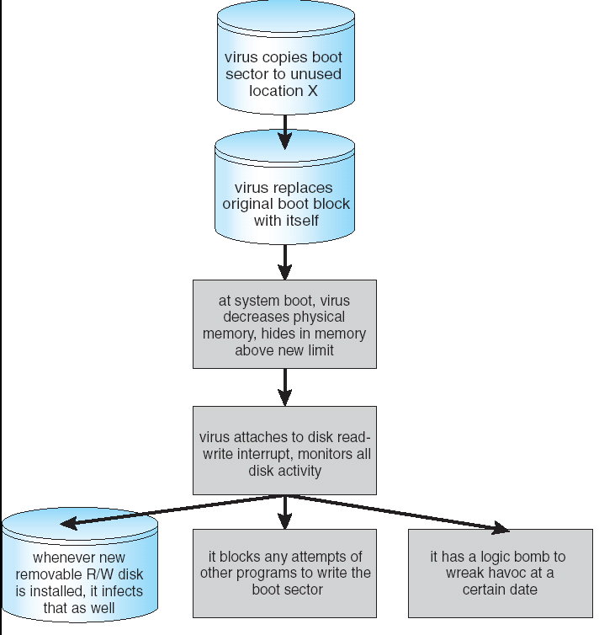
A Boot-sector Computer Virus
Prof. Dr. Iliya Georgiev Information Systems Security
Notes:
Prof. Dr. Iliya Georgiev

Slide 12
System and Network Threats
Worms – use spawn mechanism; standalone program
Internet worm
  Exploited UNIX networking features (remote access) and bugs in finger and sendmail programs
  Grappling hook program uploaded main worm program
Port scanning
  Automated attempt to connect to a range of ports on one or a range of IP addresses
Denial of Service
  Overload the targeted computer preventing it from doing any useful work
  Distributed denial-of-service (DDOS) come from multiple sites at once
Prof. Dr. Iliya Georgiev Information Systems Security
Notes:
Prof. Dr. Iliya Georgiev

Slide 13
What is Information System security?
Confidentiality: only sender, intended receiver should “understand” message contents
  sender encrypts message
  receiver decrypts message
Authentication: sender, receiver want to confirm identity of each other .
Then send “username-password”
Message Integrity: sender, receiver want to ensure message not altered (in transit, or afterwards) without detection
Access and Availability: services must be accessible and available to users
Non Repudiation – proof that an entity performed an action (for example, a session participant cannot deny that it send a message)
Prof. Dr. Iliya Georgiev Information Systems Security
Notes:
Prof. Dr. Iliya Georgiev

Slide 14



Friends and enemies: Alice, Bob, Trudy
well-known in network security world
Bob, Alice (lovers!) want to communicate “securely”
Trudy (intruder) may intercept, delete, add messages
Alice
Bob
channel
data, control messages
secure
sender
secure
receiver
data
data
Trudy
Prof. Dr. Iliya Georgiev Information Systems Security
Notes:
Prof. Dr. Iliya Georgiev

Slide 15
Who might Bob, Alice be?
… well, real-life Bobs and Alices!
Web browser/server for electronic transactions (e.g., on-line purchases)
on-line banking client/server
DNS servers
routers exchanging routing table updates
other examples?
Prof. Dr. Iliya Georgiev Information Systems Security
Notes:
Prof. Dr. Iliya Georgiev

Slide 16
There are bad guys (and girls) out there!
Q: What can a “bad guy” do?
A: a lot!
  eavesdrop: intercept messages
  actively insert messages into connection
  impersonation: can fake (spoof) source address in packet (or any field in packet)
  hijacking: “take over” ongoing connection by removing sender or receiver, inserting himself in place
  denial of service: prevent service from being used by others (e.g., by overloading resources)
more on this later ……
Prof. Dr. Iliya Georgiev Information Systems Security
Notes:
Prof. Dr. Iliya Georgiev

Slide 17

The language of cryptography
Alice’s
encryption
key
Bob’s
decryption
key
K
K
A
B
plaintext
encryption
algorithm
ciphertext
decryption
algorithm
plaintext
symmetric key crypto: sender, receiver keys identical
public-key crypto: encryption key public, decryption key secret (private)
Prof. Dr. Iliya Georgiev Information Systems Security
Notes:
Prof. Dr. Iliya Georgiev

Slide 18
Symmetric key cryptography
substitution cipher: substituting one thing for another
  monoalphabetic cipher: substitute one letter for another
plaintext: abcdefghijklmnopqrstuvwxyz
ciphertext: mnbvcxzasdfghjklpoiuytrewq
E.g.:
Plaintext: bob. i love you. alice
ciphertext: nkn. s gktc wky. mgsbc
Q: How hard to break this simple cipher?:
  brute force (how hard?)
  other?
Prof. Dr. Iliya Georgiev Information Systems Security
Notes:
Prof. Dr. Iliya Georgiev

Slide 19
Symmetric key cryptography
K
K
A-B
A-B
plaintext
message, m
encryption
algorithm
ciphertext
decryption
algorithm
plaintext
m = K ( )
K (m)
K (m)
A-B
A-B
A-B
symmetric key crypto: Bob and Alice share know same (symmetric) key: K
e.g., key is knowing substitution pattern in mono alphabetic substitution cipher
Q: how do Bob and Alice agree on key value?
A-B
Prof. Dr. Iliya Georgiev Information Systems Security
Notes:
Prof. Dr. Iliya Georgiev

Slide 20
Symmetric key crypto: DES
DES: Data Encryption Standard
US encryption standard [NIST 1993]
56-bit symmetric key, 64-bit plaintext input
How secure is DES?
  DES Challenge: 56-bit-key-encrypted phrase (“Strong cryptography makes the world a safer place”) decrypted (brute force) in 4 months
  no known “backdoor” decryption approach
making DES more secure:
  use three keys sequentially (3-DES) on each datum
  use cipher-block chaining
Prof. Dr. Iliya Georgiev Information Systems Security
Notes:
Prof. Dr. Iliya Georgiev

Slide 21

Symmetric key crypto: DES
DES operation
initial permutation
16 identical “rounds” of function application, each using different 48 bits of key
final permutation
Prof. Dr. Iliya Georgiev Information Systems Security
Notes:
Prof. Dr. Iliya Georgiev

Slide 22
AES: Advanced Encryption Standard
new (Nov. 2001) symmetric-key NIST standard, replacing DES
processes data in 128 bit blocks
128, 192, or 256 bit keys
brute force decryption (try each key) taking 1 sec on DES, takes 149 trillion years for AES
Prof. Dr. Iliya Georgiev Information Systems Security
Notes:
Prof. Dr. Iliya Georgiev

Slide 23

Public Key Cryptography
symmetric key crypto
requires sender, receiver know shared secret key
Q: how to agree on key in first place (particularly if never “met”)?
public key cryptography
radically different approach [Diffie-Hellman76, RSA78]
sender, receiver do not share secret key
public encryption key known to all
private decryption key known only to receiver
Prof. Dr. Iliya Georgiev Information Systems Security
Notes:
Prof. Dr. Iliya Georgiev

Slide 24
Public key cryptography
+
Bob’s public
key
K
B
-
Bob’s private
key
K
B
plaintext
message, m
encryption
algorithm
ciphertext
decryption
algorithm
plaintext
message
+
K (m)
-
+
B
m = K (K (m))
B
B
Prof. Dr. Iliya Georgiev Information Systems Security
Notes:
Prof. Dr. Iliya Georgiev

Slide 25
Public key encryption algorithms
Requirements:
.
.
+
-
1
need K ( ) and K ( ) such that
B
B
-
+
K (K (m)) = m
B
B
2
+
given public key K , it should be impossible to compute private key K
B
-
B
RSA: Rivest, Shamir, Adelson algorithm
Prof. Dr. Iliya Georgiev Information Systems Security
Notes:
Prof. Dr. Iliya Georgiev

Slide 26
RSA: Choosing keys
1. Choose two large prime numbers p, q.
(e.g., 1024 bits each)
2. Compute n = pq, z = (p-1)(q-1)
3. Choose e (with e<n) that has no common factors
with z. (e, z are “relatively prime”).
4. Choose d such that ed-1 is exactly divisible by z.
(in other words: ed mod z = 1 ).
5. Public key is (n,e). Private key is (n,d).
+
-
K
K
B
B
Prof. Dr. Iliya Georgiev Information Systems Security
Notes:
Prof. Dr. Iliya Georgiev

Slide 27
RSA: Encryption, decryption
0. Given (n,e) and (n,d) as computed above
1. To encrypt bit pattern, m, compute
e
e
c = m mod n
(i.e., remainder when m is divided by n)
2. To decrypt received bit pattern, c, compute
d
d
m = c mod n
(i.e., remainder when c is divided by n)
Magic
happens!
e
d
m = (m mod n)
mod n
c
Prof. Dr. Iliya Georgiev Information Systems Security
Notes:
Prof. Dr. Iliya Georgiev

Slide 28
RSA example:
Bob chooses p=5, q=7. Then n=35, z=24.
e=5 (so e, z relatively prime).
d=29 (so ed-1 exactly divisible by z.
m
e
e
letter
m
c = m mod n
encrypt:
l
12
1524832
17
d
d
c
c
m = c mod n
letter
decrypt:
17
481968572106750915091411825223071697
12
l
Prof. Dr. Iliya Georgiev Information Systems Security
Notes:
Prof. Dr. Iliya Georgiev

Slide 29
RSA: Why is that
e
d
m = (m mod n)
mod n
Useful number theory result: If p,q prime and
n = pq, then:
y
y mod (p-1)(q-1)
x mod n = x mod n
e
d
ed
(m mod n)
mod n = m mod n
ed mod (p-1)(q-1)
= m mod n
(using number theory result above)
1
= m mod n
(since we chose ed to be divisible by
(p-1)(q-1) with remainder 1 )
= m
Prof. Dr. Iliya Georgiev Information Systems Security
Notes:
Prof. Dr. Iliya Georgiev

Slide 30
RSA: another important property
The following property will be very useful later:
-
+
+
-
K (K (m)) = m
=
K (K (m))
B
B
B
B
use public key first, followed by private key
use private key first, followed by public key
Result is the same!
Prof. Dr. Iliya Georgiev Information Systems Security
Notes:
Prof. Dr. Iliya Georgiev

Slide 31
Authentication
Goal: Bob wants Alice to “prove” her identity to him
Protocol ap1.0: Alice says “I am Alice”
“I am Alice”
Failure scenario??
Prof. Dr. Iliya Georgiev Information Systems Security
Notes:
Prof. Dr. Iliya Georgiev

Slide 32
Authentication
Goal: Bob wants Alice to “prove” her identity to him
Protocol ap1.0: Alice says “I am Alice”
in a network,
Bob can not “see” Alice, so Trudy simply declares
herself to be Alice
“I am Alice”
Prof. Dr. Iliya Georgiev Information Systems Security
Notes:
Prof. Dr. Iliya Georgiev

Slide 33
Authentication: another try
Protocol ap2.0: Alice says “I am Alice” in an IP packet
containing her source IP address
Alice’s
IP address
“I am Alice”
Failure scenario??
Prof. Dr. Iliya Georgiev Information Systems Security
Notes:
Prof. Dr. Iliya Georgiev

Slide 34
Authentication: another try
Protocol ap2.0: Alice says “I am Alice” in an IP packet
containing her source IP address
Trudy can create
a packet “spoofing”
Alice’s address
Alice’s
IP address
“I am Alice”
Prof. Dr. Iliya Georgiev Information Systems Security
Notes:
Prof. Dr. Iliya Georgiev

Slide 35
Authentication: another try
Protocol ap3.0: Alice says “I am Alice” and sends her
secret password to “prove” it.
Alice’s
IP addr
Alice’s
password
“I’m Alice”
Failure scenario??
Alice’s
IP addr
OK
Prof. Dr. Iliya Georgiev Information Systems Security
Notes:
Prof. Dr. Iliya Georgiev

Slide 36

Authentication: another try
Protocol ap3.0: Alice says “I am Alice” and sends her
secret password to “prove” it.
Alice’s
IP addr
Alice’s
password
“I’m Alice”
playback attack: Trudy records Alice’s packet
and later
plays it back to Bob
Alice’s
IP addr
OK
Alice’s
IP addr
Alice’s
password
“I’m Alice”
Prof. Dr. Iliya Georgiev Information Systems Security
Notes:
Prof. Dr. Iliya Georgiev

Slide 37
Authentication: yet another try
Protocol ap3.1: Alice says “I am Alice” and sends her
encrypted secret password to “prove” it.
Alice’s
IP addr
encrypted
password
“I’m Alice”
Failure scenario??
Alice’s
IP addr
OK
Prof. Dr. Iliya Georgiev Information Systems Security
Notes:
Prof. Dr. Iliya Georgiev

Slide 38
Authentication: another try
Protocol ap3.1: Alice says “I am Alice” and sends her
encrypted secret password to “prove” it.
Alice’s
IP addr
encryppted
password
“I’m Alice”
record
and
playback
still works!
Alice’s
IP addr
OK
Alice’s
IP addr
encrypted
password
“I’m Alice”
Prof. Dr. Iliya Georgiev Information Systems Security
Notes:
Prof. Dr. Iliya Georgiev

Slide 39
Authentication: yet another try
Goal: avoid playback attack
Nonce: number (R) used only once –in-a-lifetime
ap4.0: to prove Alice “live”, Bob sends Alice nonce, R. Alice
must return R, encrypted with shared secret key
“I am Alice”
R
K (R)
Alice is live, and only Alice knows key to encrypt nonce, so it must be Alice!
A-B
Failures, drawbacks?
Prof. Dr. Iliya Georgiev Information Systems Security
Notes:
Prof. Dr. Iliya Georgiev

Slide 40
Authentication: ap5.0
ap4.0 requires shared symmetric key
can we authenticate using public key techniques?
ap5.0: use nonce, public key cryptography
“I am Alice”
Bob computes
R
+
-
-
K
(K (R)) = R
K (R)
A
A
A
and knows only Alice could have the private key, that encrypted R such that
“send me your public key”
+
K
A
+
-
K
(K (R)) = R
A
A
Prof. Dr. Iliya Georgiev Information Systems Security
Notes:
Prof. Dr. Iliya Georgiev

Slide 41
ap5.0: security hole
Man (woman) in the middle attack: Trudy poses as Alice (to Bob) and as Bob (to Alice)
I am Alice
I am Alice
R
-
K (R)
T
R
-
Send me your public key
K (R)
+
A
K
T
Send me your public key
+
K
A
+
K (m)
Trudy gets
T
-
+
+
m = K (K (m))
K (m)
T
T
A
sends m to Alice ennrypted with Alice’s public key
-
+
m = K (K (m))
A
A
Prof. Dr. Iliya Georgiev Information Systems Security
Notes:
Prof. Dr. Iliya Georgiev

Slide 42
ap5.0: security hole
Man (woman) in the middle attack: Trudy poses as Alice (to Bob) and as Bob (to Alice)
Difficult to detect:
Bob receives everything that Alice sends, and vice versa. (e.g., so Bob, Alice can meet one week later and recall conversation)
problem is that Trudy receives all messages as well!
Prof. Dr. Iliya Georgiev Information Systems Security
Notes:
Prof. Dr. Iliya Georgiev

Slide 43
Message integrity -> Digital Signatures
Cryptographic technique analogous to hand-written signatures.
sender (Bob) digitally signs document, establishing he is document owner/creator.
verifiable, nonforgeable: recipient (Alice) can prove to someone that Bob, and no one else (including Alice), must have signed document
Prof. Dr. Iliya Georgiev Information Systems Security
Notes:
Prof. Dr. Iliya Georgiev

Slide 44
Message integrity -> Digital Signatures
Simple digital signature for message m:
Bob signs m by encrypting with his private key K_{B}, creating “signed” message, K_{B}(m)
-
-
Bob’s message, m
-
Bob’s private
key
-
K
K
(m)
B
B
Dear Alice
Oh, how I have missed you. I think of you all the time! …(blah blah blah)
Bob
Bob’s message, m, signed (encrypted) with his private key
Public key
encryption
algorithm
Prof. Dr. Iliya Georgiev Information Systems Security
Notes:
Prof. Dr. Iliya Georgiev

Slide 45
Message integrity -> Digital Signatures (more)
-
Suppose Alice receives msg m, digital signature K_{B}(m)
Alice verifies m signed by Bob by applying Bob’s public key K_{B} to K_{B}(m) then checks K_{B}(K_{B}(m) ) = m.
If K_{B}(K_{B}(m) ) = m, whoever signed m must have used Bob’s private key.
+
-
+
-
+
-
Alice thus verifies that:
  Bob signed m.
  No one else signed m.
  Bob signed m and not m’.
Non-repudiation:
  Alice can take m, and signature K_{B}(m) to court and prove that Bob signed m.
-
Prof. Dr. Iliya Georgiev Information Systems Security
Notes:
Prof. Dr. Iliya Georgiev

Slide 46
Message integrity Message Digests
large
message
m
H: Hash
Function
Computationally expensive to public-key-encrypt long messages
Goal: fixed-length, easy- to-compute digital “fingerprint”
apply hash function H to m, get fixed size message digest, H(m).
H(m)
Hash function properties:
many-to-1
produces fixed-size msg digest (fingerprint)
given message digest x, computationally infeasible to find m such that x = H(m)
Prof. Dr. Iliya Georgiev Information Systems Security
Notes:
Prof. Dr. Iliya Georgiev

Slide 47
Internet checksum: poor crypto hash function
Internet checksum has some properties of hash function:
produces fixed length digest (16-bit sum) of message
is many-to-one
But given message with given hash value, it is easy to find another message with same hash value:
message
ASCII format
message
ASCII format
I O U 1
0 0 . 9
9 B O B
49 4F 55 31
30 30 2E 39
39 42 D2 42
I O U 9
0 0 . 1
9 B O B
49 4F 55 39
30 30 2E 31
39 42 D2 42
B2 C1 D2 AC
different messages
but identical checksums!
B2 C1 D2 AC
Prof. Dr. Iliya Georgiev Information Systems Security
Notes:
Prof. Dr. Iliya Georgiev

Slide 48

Digital signature = signed message digest
Alice verifies signature and integrity of digitally signed message:
Bob sends digitally signed message:
large
message
m
H: Hash
function
encrypted
msg digest
H(m)
-
K_{B}(H(m))
Bob’s
private
key
digital
signature
(encrypt)
large
message
m
-
Bob’s
public
key
digital
signature
(decrypt)
K
B
+
H: Hash
function
K
encrypted
msg digest
B
+
-
K_{B}(H(m))
H(m)
H(m)
equal
?
Prof. Dr. Iliya Georgiev Information Systems Security
Notes:
Prof. Dr. Iliya Georgiev

Slide 49
Hash Function Algorithms
MD5 hash function widely used (RFC 1321)
  computes 128-bit message digest in 4-step process.
  arbitrary 128-bit string x, appears difficult to construct msg m whose MD5 hash is equal to x.
SHA-1 is also used.
  US standard [NIST, FIPS PUB 180-1]
  160-bit message digest
Prof. Dr. Iliya Georgiev Information Systems Security
Notes:
Prof. Dr. Iliya Georgiev

Slide 50
Key distribution and certification
Trusted Intermediaries
Symmetric key problem:
How do two entities establish shared secret key over network?
Solution:
trusted key distribution center (KDC) acting as intermediary between entities
Public key problem:
When Alice obtains Bob’s public key (from web site, e-mail, diskette), how does she know it is Bob’s public key, not Trudy’s?
Solution:
trusted certification authority (CA)
Prof. Dr. Iliya Georgiev Information Systems Security
Notes:
Prof. Dr. Iliya Georgiev

Slide 51


Key Distribution Center (KDC)
Alice, Bob need shared symmetric key.
KDC: server shares different secret key with each registered user (many users)
Alice, Bob know own symmetric keys, K_{A-KDC} K_{B-KDC} , for communicating with KDC.
KDC
K_{A-KDC}
K_{P-KDC}
K_{X-KDC}
K_{P-KDC}
K_{B-KDC}
K_{Y-KDC}
K_{Z-KDC}
K_{A-KDC}
K_{B-KDC}
Prof. Dr. Iliya Georgiev Information Systems Security
Notes:
Prof. Dr. Iliya Georgiev

Slide 52
Key Distribution Center (KDC)
Q: How does KDC allow Bob, Alice to determine shared symmetric secret key to communicate with each other?
KDC generates R1
K_{A-KDC}(A,B)
Alice
knows R1
K_{A-KDC}(R1, K_{B-KDC}(A,R1) )
Bob knows to use R1 to communicate with Alice
K_{B-KDC}(A,R1)
Alice and Bob communicate: using R1 as
session key for shared symmetric encryption
Prof. Dr. Iliya Georgiev Information Systems Security
Notes:
Prof. Dr. Iliya Georgiev

Slide 53

Certification Authorities
Certification authority (CA): binds public key to particular entity, E.
E (person, router) registers its public key with CA.
  E provides “proof of identity” to CA.
  CA creates certificate binding E to its public key.
  certificate containing E’s public key digitally signed by CA – CA says “this is E’s public key”
Bob’s
public
key
digital
signature
(encrypt)
+
K
+
B
K
B
CA
private
key
certificate for Bob’s public key, signed by CA
Bob’s
identifying information
-
K
CA
Prof. Dr. Iliya Georgiev Information Systems Security
Notes:
Prof. Dr. Iliya Georgiev

Slide 54
Certification Authorities
When Alice wants Bob’s public key:
  gets Bob’s certificate (Bob or elsewhere).
  apply CA’s public key to Bob’s certificate, get Bob’s public key
+
digital
signature
(decrypt)
Bob’s
public
key
K
B
+
K
B
CA
public
key
+
K
CA
Prof. Dr. Iliya Georgiev Information Systems Security
Notes:
Prof. Dr. Iliya Georgiev

Slide 55
Access control: firewalls
firewall
isolates organization’s internal net from larger Internet, allowing some packets to pass, blocking others.
administered
network
public
Internet
firewall
Prof. Dr. Iliya Georgiev Information Systems Security
Notes:
Prof. Dr. Iliya Georgiev

Slide 56
Firewalls: Why
prevent denial of service attacks:
  SYN flooding: attacker establishes many bogus TCP connections, no resources left for “real” connections.
prevent illegal modification/access of internal data.
  e.g., attacker replaces CIA’s homepage with something else
allow only authorized access to inside network (set of authenticated users/hosts)
two types of firewalls:
  application-level
  packet-filtering
Prof. Dr. Iliya Georgiev Information Systems Security
Notes:
Prof. Dr. Iliya Georgiev

Slide 57
Packet Filtering
Example 1: block incoming and outgoing datagrams with IP protocol field = 17 and with either source or dest port = 23.
  All incoming and outgoing UDP flows and telnet connections are blocked.
Example 2: Block inbound TCP segments with ACK=0.
  Prevents external clients from making TCP connections with internal clients, but allows internal clients to connect to outside.
Prof. Dr. Iliya Georgiev Information Systems Security
Notes:
Prof. Dr. Iliya Georgiev

Slide 58
Limitations of firewalls and gateways
IP spoofing: router can’t know if data “really” comes from claimed source
if multiple app’s. need special treatment, each has own app. gateway.
client software must know how to contact gateway.
  e.g., must set IP address of proxy in Web browser
filters often use all or nothing policy for UDP.
tradeoff: degree of communication with outside world, level of security
many highly protected sites still suffer from attacks.
Prof. Dr. Iliya Georgiev Information Systems Security
Notes:
Prof. Dr. Iliya Georgiev

Slide 59
Attacks and counter measures
Internet security threats
Mapping:
  before attacking: “case the joint” – find out what services are implemented on network
  Use ping to determine what hosts have addresses on network
  Port-scanning: try to establish TCP connection to each port in sequence (see what happens)
  nmap (http://www.insecure.org/nmap/) mapper: “network exploration and security auditing”
Countermeasures?
Prof. Dr. Iliya Georgiev Information Systems Security
Notes:
Prof. Dr. Iliya Georgiev

Slide 60
Internet security threats
Mapping: countermeasures
  record traffic entering network
  look for suspicious activity (IP addresses, pots being scanned sequentially)
Prof. Dr. Iliya Georgiev Information Systems Security
Notes:
Prof. Dr. Iliya Georgiev

Slide 61

Internet security threats
Packet sniffing:
  broadcast media
  promiscuous NIC reads all packets passing by
  can read all unencrypted data (e.g. passwords)
  e.g.: C sniffs B’s packets
A
C
src:B dest:A payload
B
Countermeasures?
Prof. Dr. Iliya Georgiev Information Systems Security
Notes:
Prof. Dr. Iliya Georgiev

Slide 62
Internet security threats
Packet sniffing: countermeasures
  all hosts in organization run software that checks periodically if host interface in promiscuous mode.
  one host per segment of broadcast media (switched Ethernet at hub)
A
C
src:B dest:A payload
B
Prof. Dr. Iliya Georgiev Information Systems Security
Notes:
Prof. Dr. Iliya Georgiev

Slide 63
Internet security threats
IP Spoofing:
  can generate “raw” IP packets directly from application, putting any value into IP source address field
  receiver can’t tell if source is spoofed
  e.g.: C pretends to be B
A
C
src:B dest:A payload
B
Countermeasures?
Prof. Dr. Iliya Georgiev Information Systems Security
Notes:
Prof. Dr. Iliya Georgiev

Slide 64
Internet security threats
IP Spoofing: ingress filtering
  routers should not forward outgoing packets with invalid source addresses (e.g., datagram source address not in router’s network)
  great, but ingress filtering can not be mandated for all networks
A
C
src:B dest:A payload
B
Prof. Dr. Iliya Georgiev Information Systems Security
Notes:
Prof. Dr. Iliya Georgiev

Slide 65
Internet security threats
Denial of service (DOS):
  flood of maliciously generated packets “swamp” receiver
  Distributed DOS (DDOS): multiple coordinated sources swamp receiver
  e.g., C and remote host SYN-attack A
A
C
SYN
SYN
SYN
SYN
SYN
B
Countermeasures?
SYN
SYN
Prof. Dr. Iliya Georgiev Information Systems Security
Notes:
Prof. Dr. Iliya Georgiev

Slide 66
Internet security threats
Denial of service (DOS): countermeasures
  filter out flooded packets (e.g., SYN) before reaching host: throw out good with bad
  traceback to source of floods (most likely an innocent, compromised machine)
A
C
SYN
SYN
SYN
SYN
SYN
B
SYN
SYN
Prof. Dr. Iliya Georgiev Information Systems Security
Notes:
Prof. Dr. Iliya Georgiev

Slide 67
Security in many layers
Pretty good privacy (PGP)
Internet e-mail encryption scheme, de-facto standard.
uses symmetric key cryptography, public key cryptography, hash function, and digital signature as described.
provides secrecy, sender authentication, integrity.
inventor, Phil Zimmerman, was target of 3-year federal investigation.
A PGP signed message:
---BEGIN PGP SIGNED MESSAGE---
Hash: SHA1
Bob:My husband is out of town tonight.Passionately yours, Alice
---BEGIN PGP SIGNATURE---
Version: PGP 5.0
Charset: noconv
yhHJRHhGJGhgg/12EpJ+lo8gE4vB3mqJhFEvZP9t6n7G6m5Gw2
---END PGP SIGNATURE---
Prof. Dr. Iliya Georgiev Information Systems Security
Notes:
Prof. Dr. Iliya Georgiev

Slide 68
Secure sockets layer (SSL)
transport layer security to any TCP-based app using SSL services.
used between Web browsers, servers for e-commerce (shttp).
security services:
  server authentication
  data encryption
  client authentication (optional)
server authentication:
  SSL-enabled browser includes public keys for trusted CAs.
  Browser requests server certificate, issued by trusted CA.
  Browser uses CA’s public key to extract server’s public key from certificate.
check your browser’s security menu to see its trusted CAs.
Prof. Dr. Iliya Georgiev Information Systems Security
Notes:
Prof. Dr. Iliya Georgiev

Slide 69
SSL (continued)
Encrypted SSL session:
Browser generates symmetric session key, encrypts it with server’s public key, sends encrypted key to server.
Using private key, server decrypts session key.
Browser, server know session key
  All data sent into TCP socket (by client or server) encrypted with session key.
SSL: basis of IETF Transport Layer Security (TLS).
SSL can be used for non-Web applications, e.g., IMAP.
Client authentication can be done with client certificates.
Prof. Dr. Iliya Georgiev Information Systems Security
Notes:
Prof. Dr. Iliya Georgiev

Slide 70
User Authentication
Crucial to identify user correctly, as protection systems depend on user ID
User identity most often established through passwords, can be considered a special case of either keys or capabilities
  Also can include something user has and /or a user attribute
Passwords must be kept secret
  Frequent change of passwords
  Use of “non-guessable” passwords
  Log all invalid access attempts
Passwords may also either be encrypted or allowed to be used only once
Prof. Dr. Iliya Georgiev Information Systems Security
Notes:
Prof. Dr. Iliya Georgiev

Slide 71
Implementing Security Defenses
Defense in depth is most common security theory – multiple layers of security
Security policy describes what is being secured
Vulnerability assessment compares real state of system / network compared to security policy
Intrusion detection endeavors to detect attempted or successful intrusions
  Signature-based detection spots known bad patterns
  Anomaly detection spots differences from normal behavior
    Can detect zero-day attacks
  False-positives and false-negatives a problem
Virus protection
Auditing, accounting, and logging of all or specific system or network activities
Prof. Dr. Iliya Georgiev Information Systems Security
Notes:
Prof. Dr. Iliya Georgiev

Slide 72
Example: Windows XP
Security is based on user accounts
  Each user has unique security ID
  Login to ID creates security access token
    Includes security ID for user, for user’s groups, and special privileges
    Every process gets copy of token
    System checks token to determine if access allowed or denied
Uses a subject model to ensure access security. A subject tracks and manages permissions for each program that a user runs
Each object in Windows XP has a security attribute defined by a security descriptor
  For example, a file has a security descriptor that indicates the access permissions for all users
Prof. Dr. Iliya Georgiev Information Systems Security
Notes:
Prof. Dr. Iliya Georgiev

Slide 73
IS Security (summary)
Basic techniques…...
  cryptography (symmetric and public)
  authentication
  message integrity
  key distribution
Prof. Dr. Iliya Georgiev Information Systems Security
Notes:
Prof. Dr. Iliya Georgiev

